Slide 1

Is it wrong to pick up a rfid project for csc 196p
Matthew Mendoza for CSC 196P: Cloud and Mobile Pragmatics

Slide 2
EPIC Fail: Watch What Happened When I Tried Playing with RFID!
Matthew Mendoza for CSC 196P: Cloud and Mobile Pragmatics

Slide 3
I Spent 24 Hours with RFID: Here's What I Discovered!
Matthew Mendoza for CSC 196P: Cloud and Mobile Pragmatics

Slide 4
What is RFID technology
1940s
Radar technology during World War II inspires the concept of RFID.
1970s
Early RFID systems emerge, primarily for security access and identification purposes.
1980s
Significant advancements lead to commercial applications in logistics and inventory management.
1990s
Adoption expands across various industries with improved technology and cost reductions.
2000s
RFID gains traction in supply chain management, retail, healthcare, and transportation.
RFID (Radio Frequency Identification) is a wireless technology for identifying and tracking objects.
Applications include inventory management, supply chain logistics, access control, and contactless payment systems.
RFID offers advantages like improved inventory accuracy and faster data collection.
Source: Wikipedia - Radio-frequency identification

Slide 5
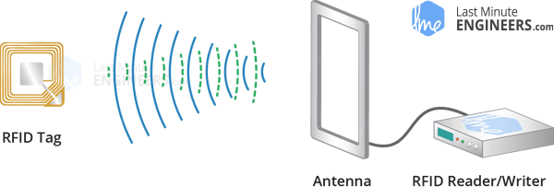
how does it work?
It uses electromagnetic fields to communicate between tags and readers.
Tags consist of a microchip and an antenna.
When within range of an RFID reader, the reader sends out radio waves.
These waves power the tag, enabling it to transmit data back to the reader.
Data typically includes unique identifiers or stored information on the tag.
Source: Last Minute Engineers - What is RFID? How It Works? Interface RC522 RFID Module with Arduino

Slide 6


The Setup

Slide 7
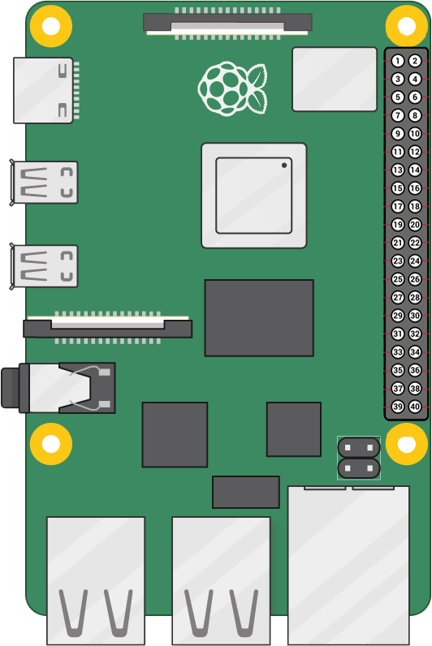
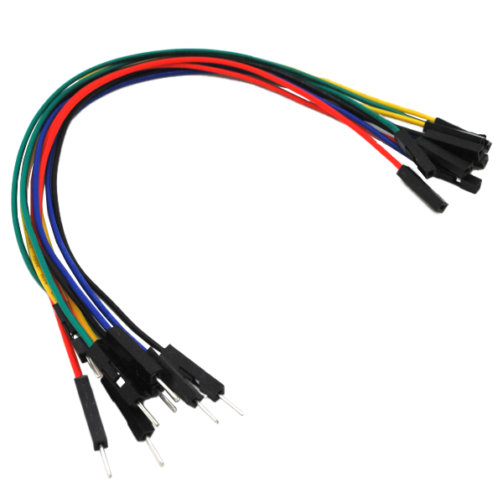
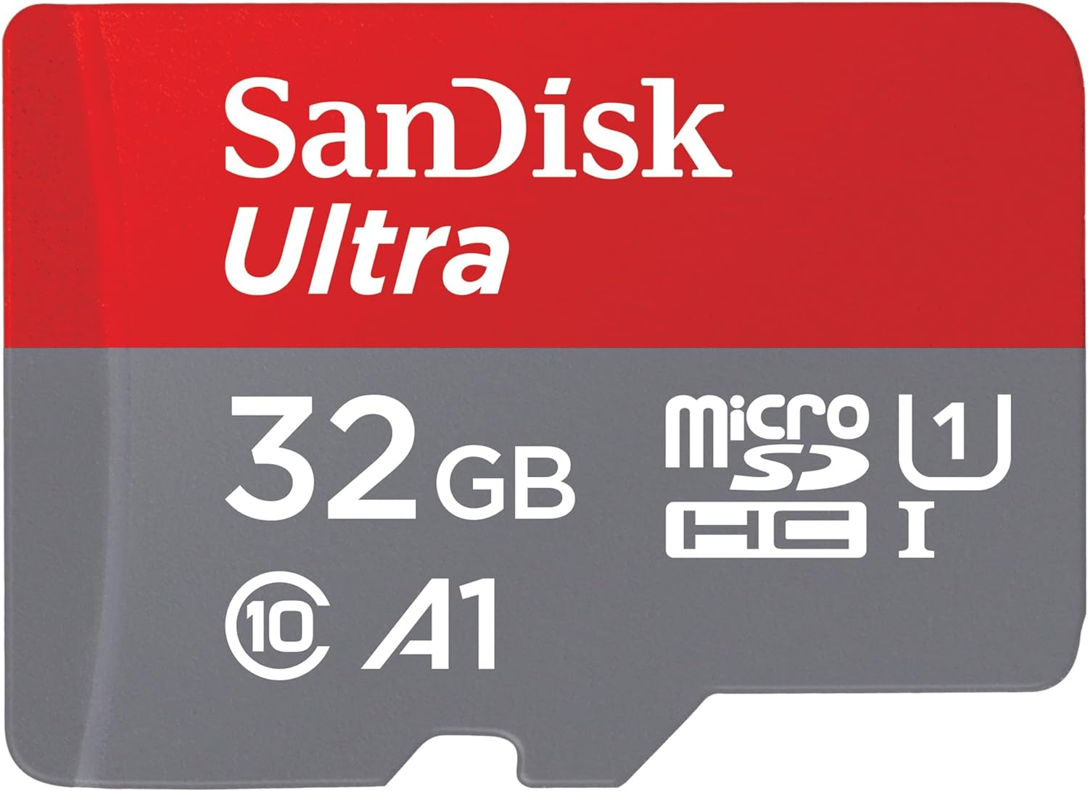
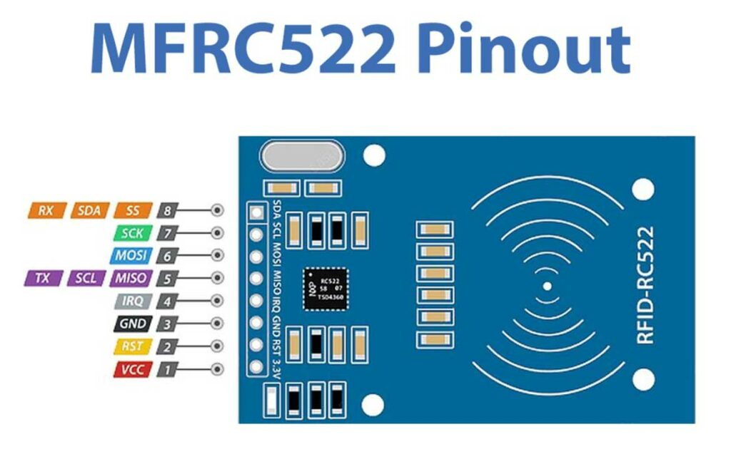
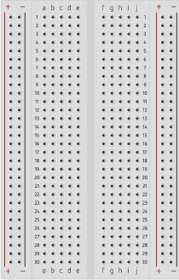

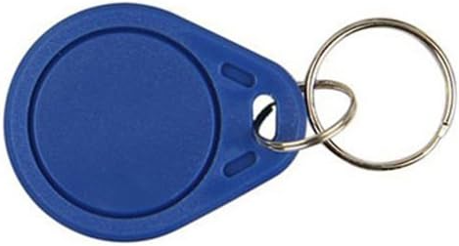
Hardware Components
Micro SD Card
Male-Female Jumper Wires
RFID Card Tag
Key Fob Tag
Mifare RC522
Module RFID Reader
Raspberry Pi 4 Model B
Breadboard

Slide 8

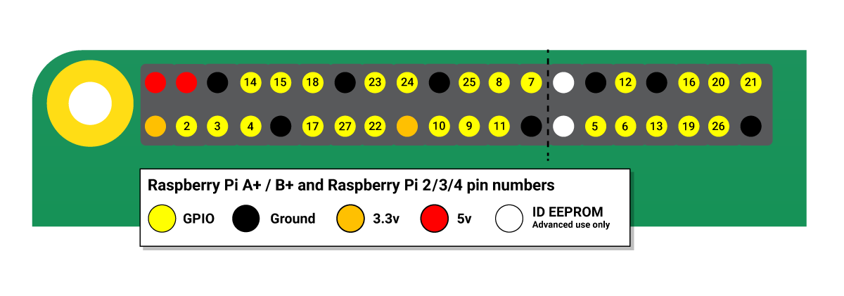
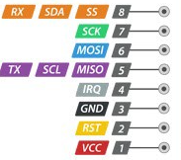
pinouts
Raspberry Pi 4 Model B
Mifare RC522Module RFID Reader
Source: Raspberry Pi GPIO and the 40-pin header, Interface RC522 RFID Module

Slide 9


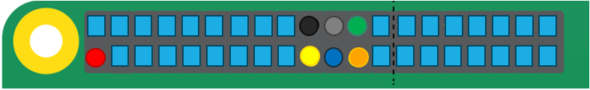
Wiring
RC522 Module (Left to Right) |  | Raspberry Pi
PIN 1: Voltage Common Collector (VCC) | Red | PIN 1: 3.3v
PIN 2: Reset (RST) | Gray | PIN 22: GPIO #25
PIN 3: Ground (GND) | Black | PIN 6: Ground (GND)
PIN 4: Interrupt Request (IRQ) |  | Not connected
PIN 5: Master In Slave Out (MISO) | Blue | PIN 21: GPIO #9 (MISO)
PIN 6: Master Out Slave In (MOSI) | GOLD | PIN 19: GPIO #10 (MOSI)
PIN 7: Serial Clock (SCK) | Orange | PIN 23: GPIO #11 (SCLK)
PIN 8: Serial Data Line (SDA) | Green | PIN 24: GPIO #8 (CE0)
Source: RC522 RFID Tag Reading with the Raspberry Pi
Notes:
RC522 Module PIN 1: Voltage at the Common Collector (VCC) - Used to Power the module, typically 3.3V is used
PIN 2: RST - Reset pin – used to reset or power down the module
PIN 3: Ground - Connected to Ground of system
PIN 5: MISO - used for SPI communication, acts as SCL for I2c and Tx for UART.
PIN 6: MOSI - Master out slave in pin for SPI communication
PIN 7: SCK - Serial Clock pin – used to provide clock source
PIN 8: SDA - Acts as Serial input (SS) for SPI communication, SDA for IIC and Rx during UART

Slide 10
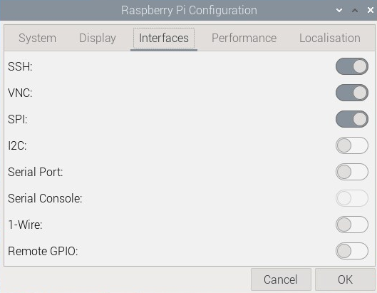
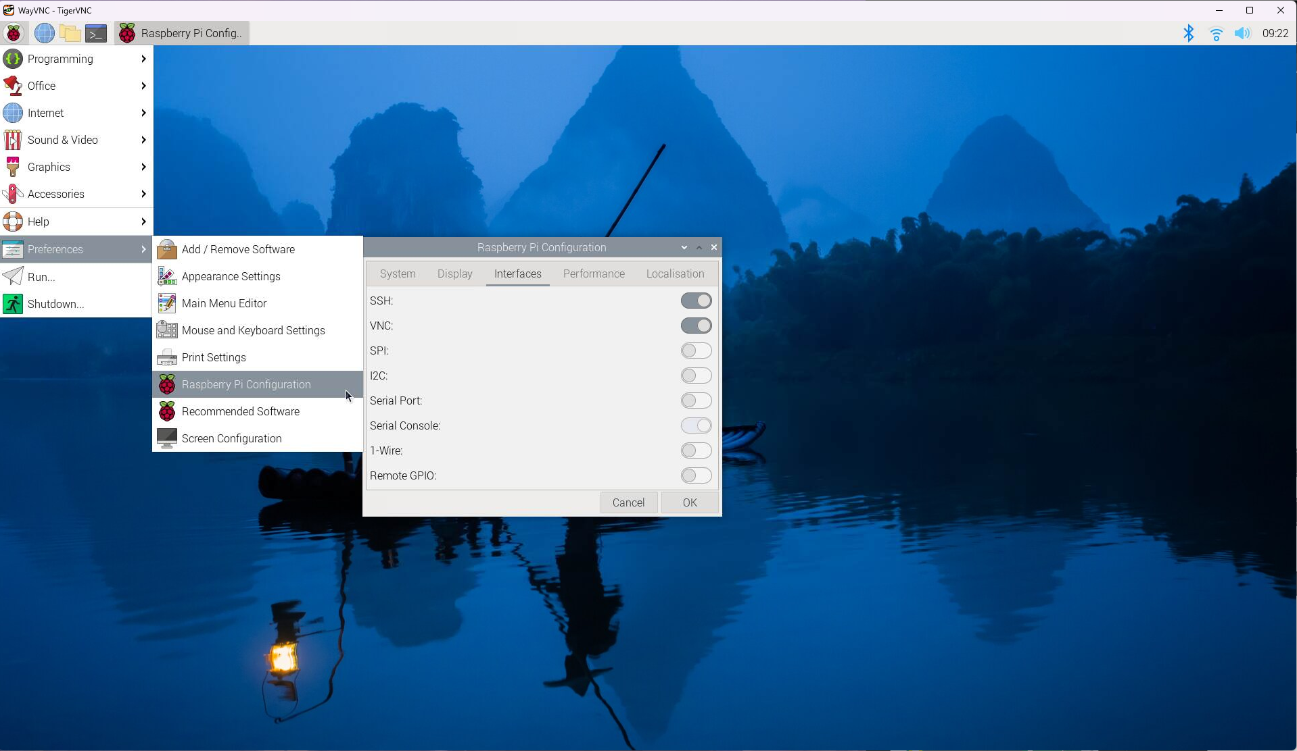
Raspberry Pi configuration
Enable Serial Peripheral Interface (SPI) connection
an interface bus commonly used to send data between microcontrollers and small peripherals such as shift registers, sensors, and SD cards. It uses separate clock and data lines, along with a select line to choose the device you wish to talk to.
1
2
3
Source: Serial Peripheral Interface (SPI)

Slide 11


Connect to the cloud via Firebase
“The cloud is just someone else's computer”

Slide 12

1) Sign-in with a google account
As of 2024/03/01

Slide 13
2) Go to console
As of 2024/03/01

Slide 14
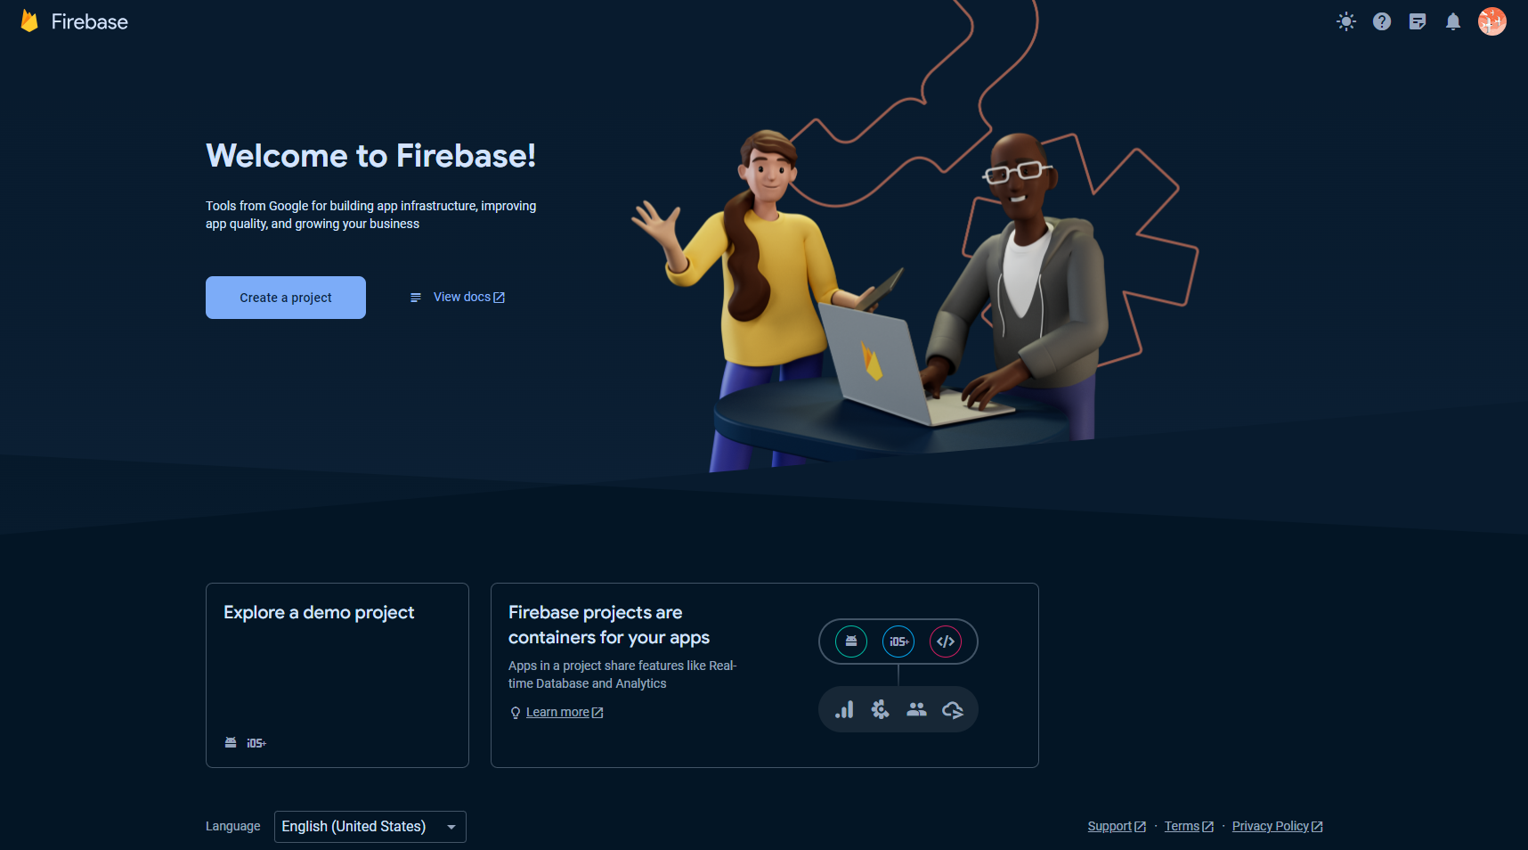
3) Create a project
As of 2024/03/01

Slide 15
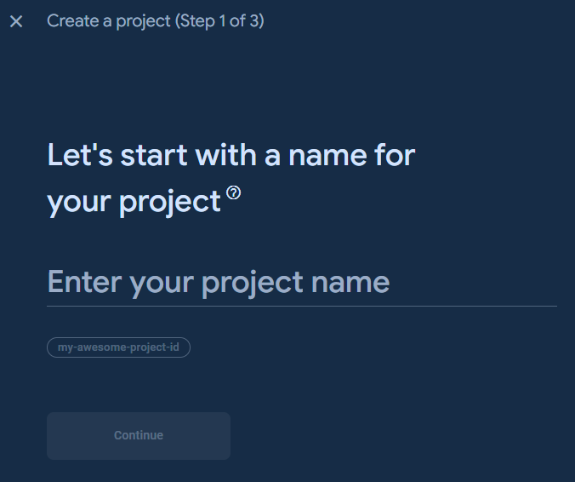

4) Give your project a name and continue
Create a project (Step 1 of 3)
As of 2024/03/01

Slide 16

5) Click Continue
Create a project (Step 2 of 3)
As of 2024/03/01

Slide 17
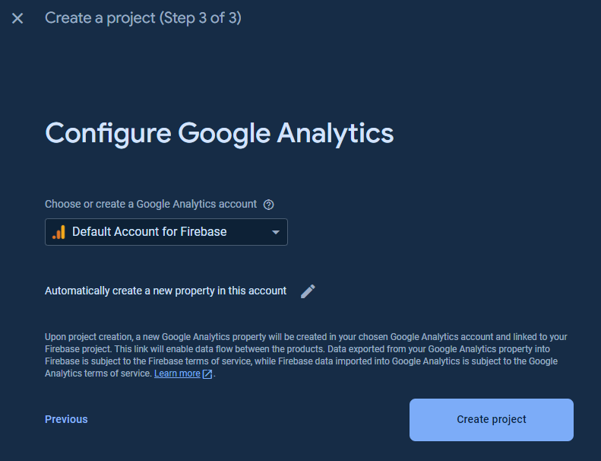
6) Configure Google Analytics
Create a project (Step 3 of 3)
As of 2024/03/01

Slide 18
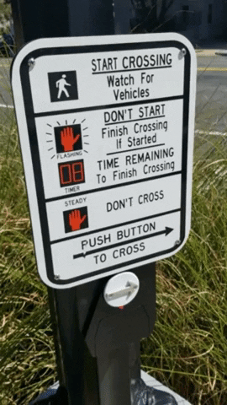
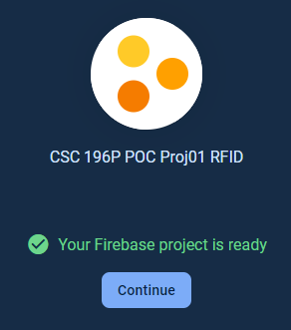
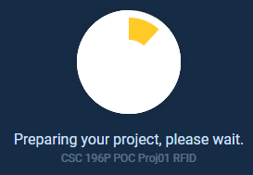

7) Wait
As of 2024/03/01

Slide 19
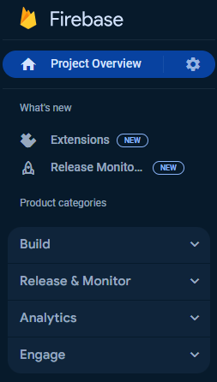
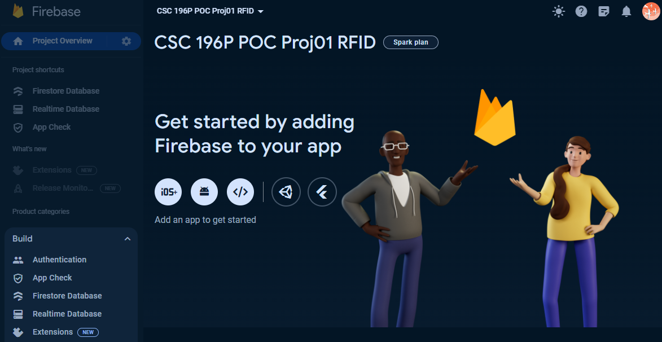
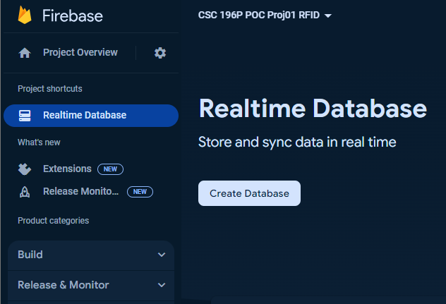
9) Create a Realtime database
From “Project categories”, under “BUILD” dropdown menu, select “Realtime Database”, Click “Create Database”
As of 2024/03/01

Slide 20
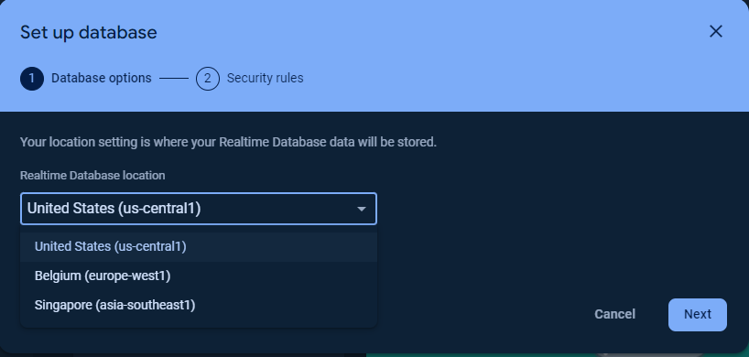
10) Set up database (part 1 of 2)
Select the region that best suits your location and click “Next”
As of 2024/03/01

Slide 21
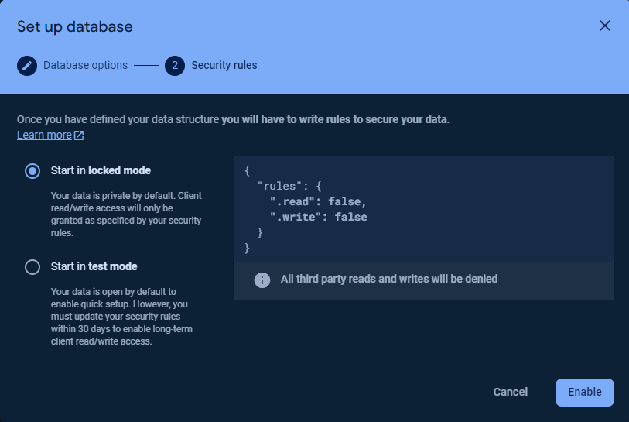
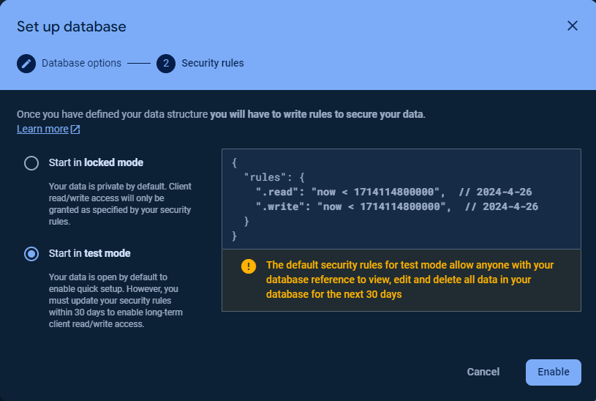
10) Set up database (part 2 of 2)
Start in locked mode
Start in test mode
As of 2024/03/01

Slide 22
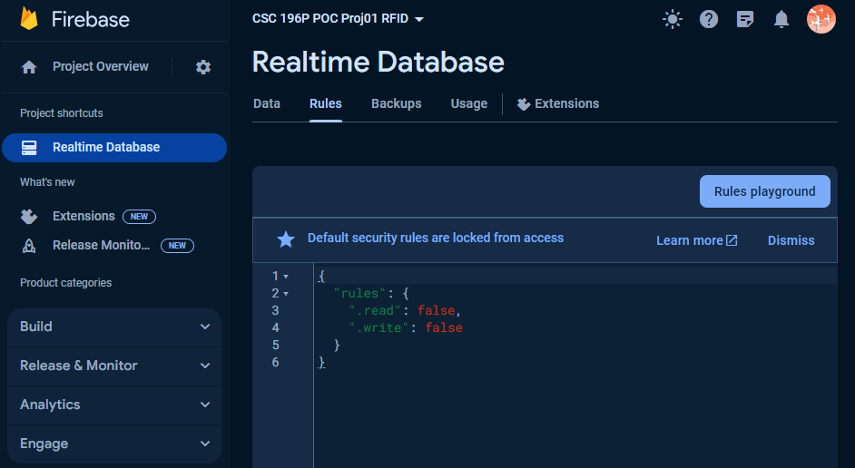
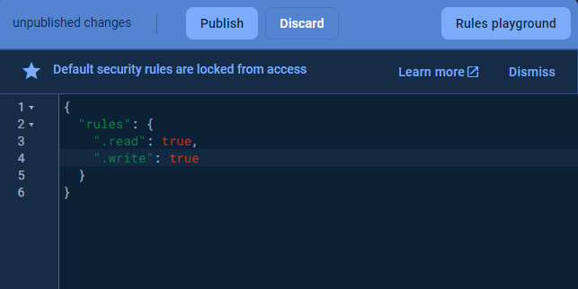
11) Edit Rules (If started in locked mode)
Go to the “Rules” tab
Change values to “true” and “Publish”
⚠️ You will get a prompt: “security rules are defined as public, so anyone can steal, modify, or delete data in your database”.
Because this is just a proof of concept this can be ignored.
As of 2024/03/01

Slide 23
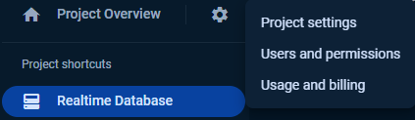
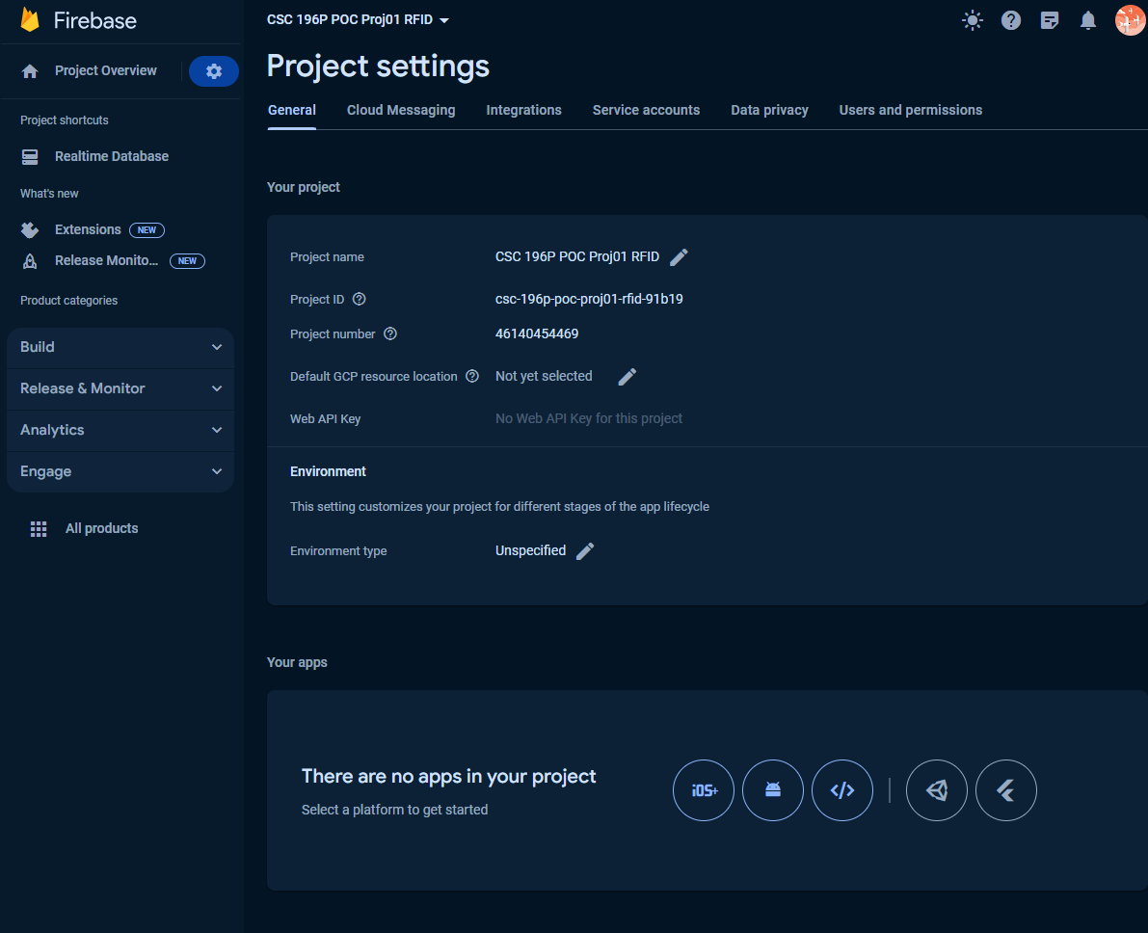
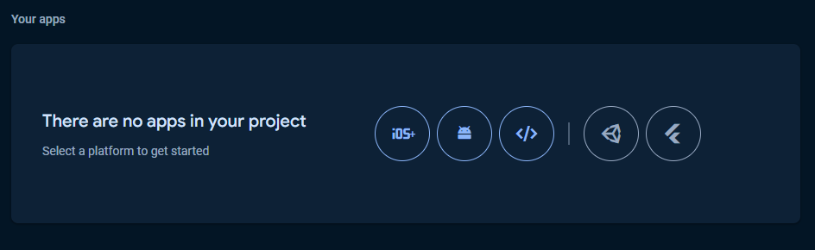
12) Project settings ➡️Add Firebase to App
Click the “gear” icon
Click “Project settings”
Scroll to the bottom of the “Project settings” page
Select the type of app you’d like to integrate with
Android
Unity (game dev)
Apple
iOS
Web
Flutter
(cross platform applications)
As of 2024/03/01

Slide 24


We are almost though

Slide 25

Implementation Web Platform via Python

Slide 26
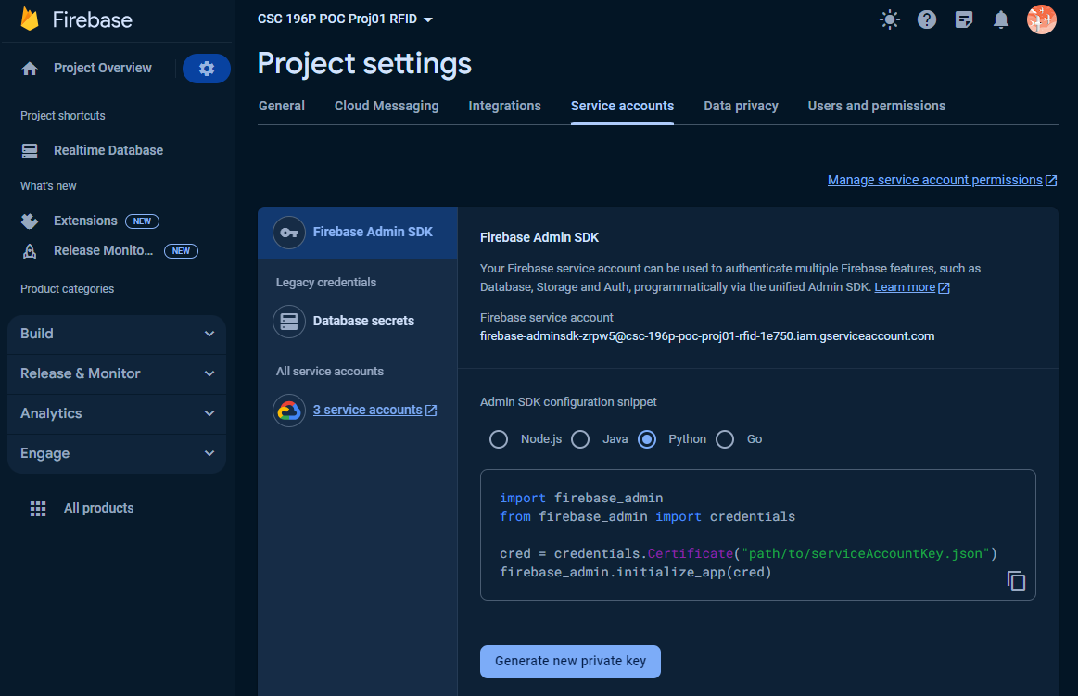
Add Firebase to your web app
To obtain the firebase_credentials.json file, you'll need to follow these steps:
Go to the Firebase Console: Visit the Firebase Console at https://console.firebase.google.com/
Select Your Project: If you already have a project, select it from the project list. If not, create a new project by clicking on the "Add project" button.
Navigate to Project Settings: Once you're in your project, click on the gear icon (settings) next to "Project Overview" in the left sidebar. Then select "Project settings".
Navigate to Service Accounts: In the project settings, select the "Service accounts" tab.
Generate New Private Key: Scroll down to the "Firebase Admin SDK" section. Under the "Firebase Admin SDK" tab, you'll see a section titled "Generate new private key". Click on the "Generate new private key" button to download the service account key file.
Save the File: Save the downloaded JSON file to a secure location on your computer. This file is your firebase_credentials.json.
Remember to keep this file secure and not share it publicly, as it contains sensitive information that grants access to your Firebase project. Once you have the firebase_credentials.json file, you can use it to initialize the Firebase Admin SDK in your Python script, as demonstrated in the previous examples.
As of 2024/03/01

Slide 27
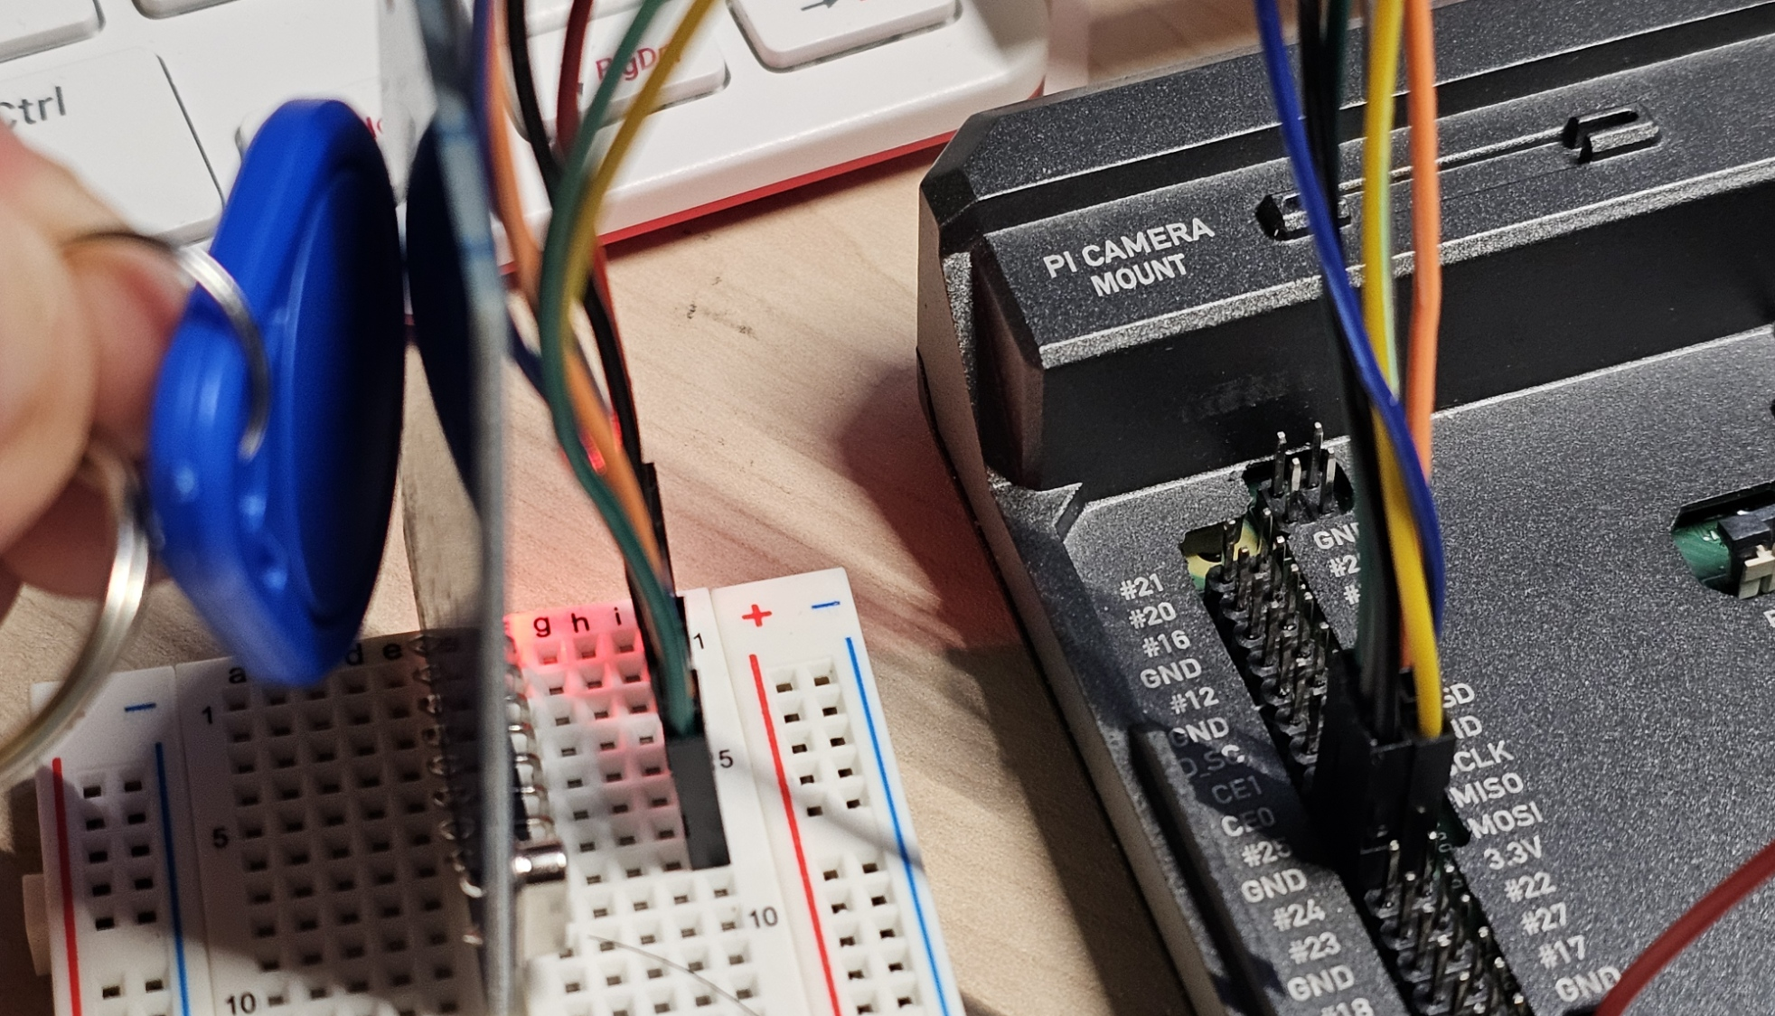
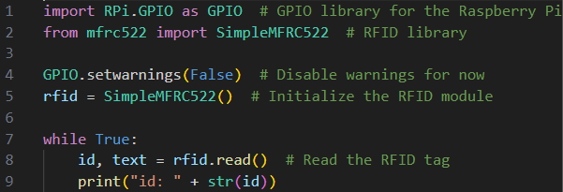
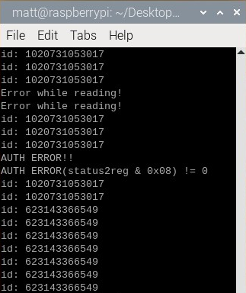
Scan for RFID Tag

Slide 28
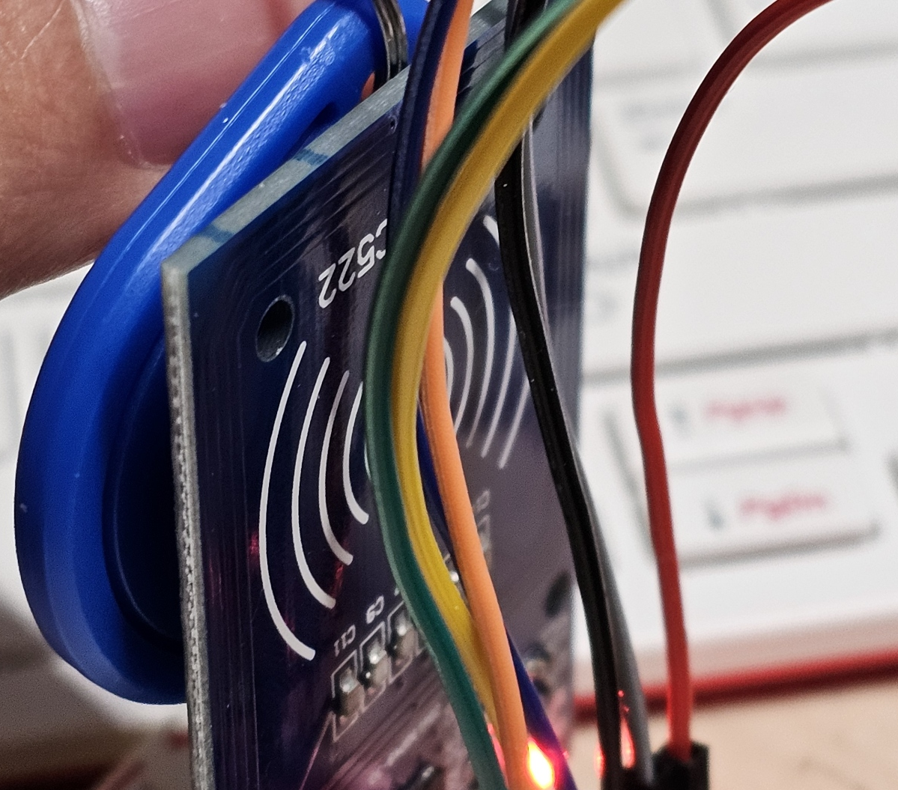
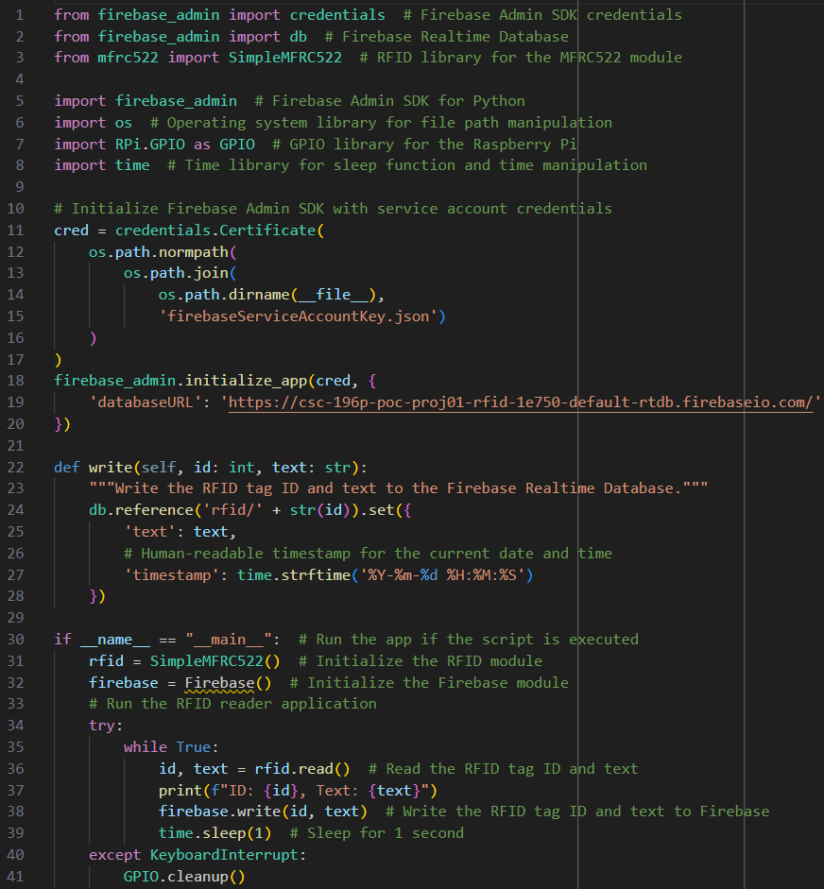
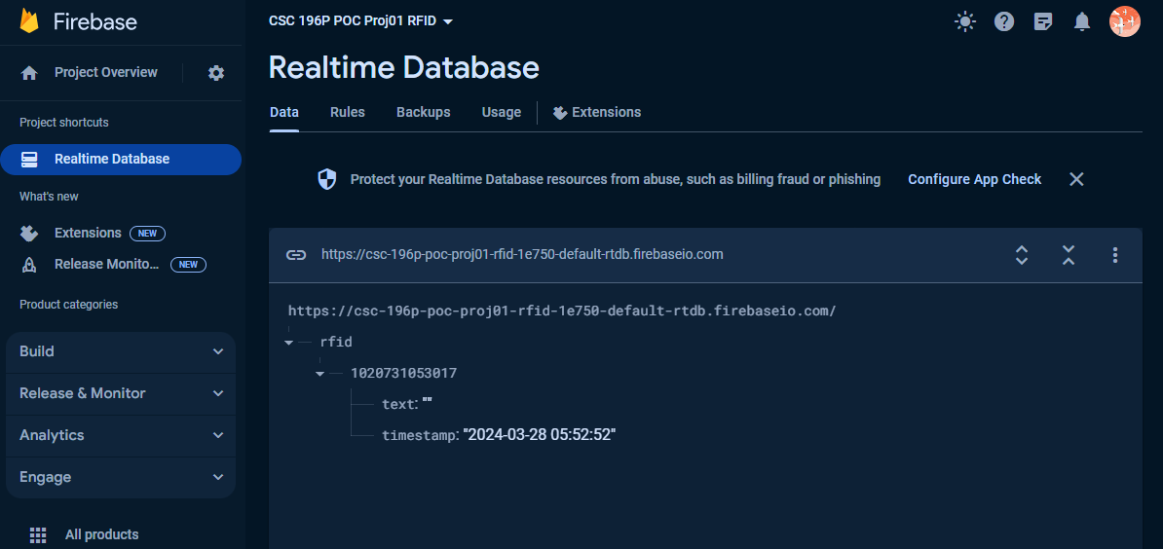
Write to Firebase Realtime Database

Slide 29


Showtime

Slide 30

The Great Swan Race!

Slide 31

Rules of the Race
RFID Card Tag
Key Fob Tag
Choose
Choose either the RFID card or key fob
Walk
Elegantly walk to the RFID reader
Be
Be the first one to scan your chosen RFID tag
🏆

Slide 32
Questions?

Slide 33
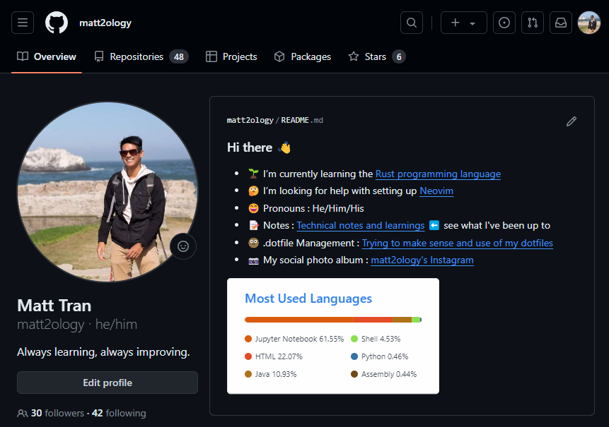
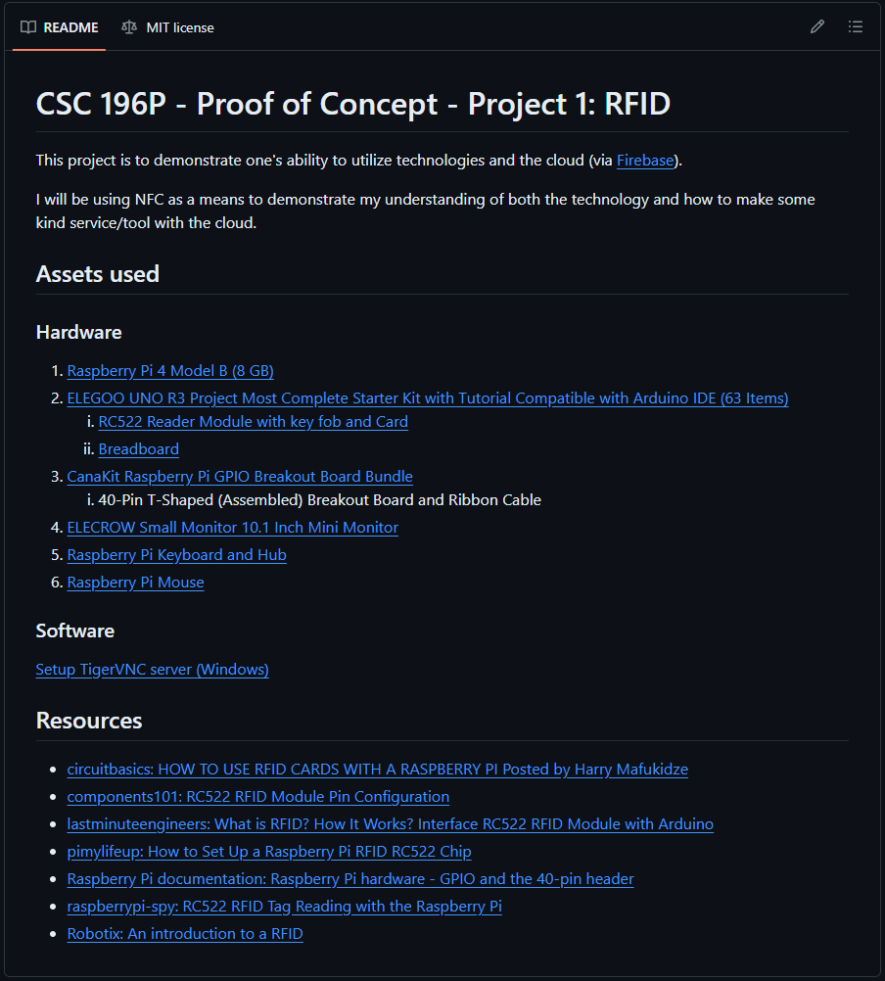
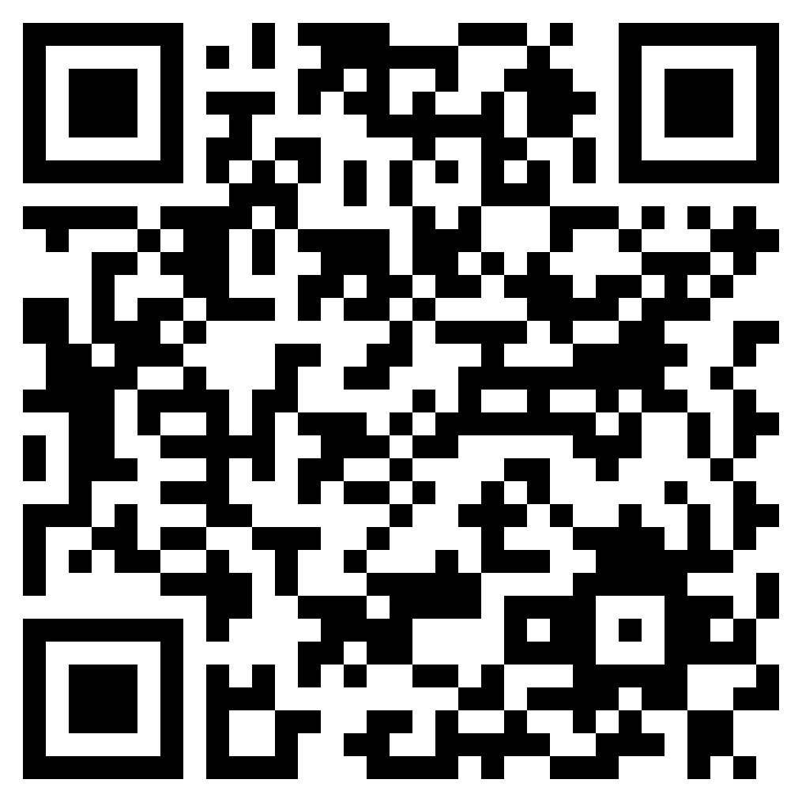
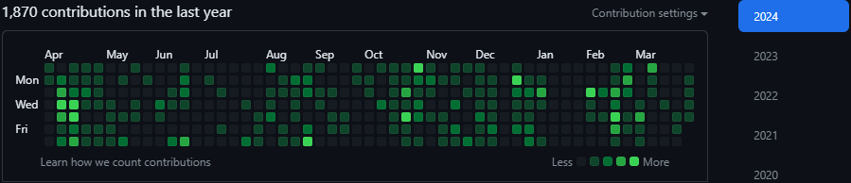
Matt2ology GitHub: POC - Project 01 - RFID

Slide 34

Thank you

Slide 35

Backup Slides

Slide 36
Wiring
RC522 Module (Left to Right) |  | Raspberry Pi
PIN 1: Voltage Common Collector (VCC) | Red | PIN 1: 3.3v
PIN 2: Reset (RST) | Gray | PIN 22: GPIO #25
PIN 3: Ground (GND) | Black | PIN 6: Ground (GND)
PIN 4: Interrupt Request (IRQ) |  | Not connected
PIN 5: Master In Slave Out (MISO) | Blue | PIN 21: GPIO #9 (MISO)
PIN 6: Master Out Slave In (MOSI) | GOLD | PIN 19: GPIO #10 (MOSI)
PIN 7: Serial Clock (SCK) | Orange | PIN 23: GPIO #11 (SCLK)
PIN 8: Serial Data Line (SDA) | Green | PIN 24: GPIO #8 (CE0)
Notes:
RC522 Module PIN 1: Voltage at the Common Collector (VCC) - Used to Power the module, typically 3.3V is used
PIN 2: RST - Reset pin – used to reset or power down the module
PIN 3: Ground - Connected to Ground of system
PIN 5: MISO - used for SPI communication, acts as SCL for I2c and Tx for UART.
PIN 6: MOSI - Master out slave in pin for SPI communication
PIN 7: SCK - Serial Clock pin – used to provide clock source
PIN 8: SDA - Acts as Serial input (SS) for SPI communication, SDA for IIC and Rx during UART

Slide 37
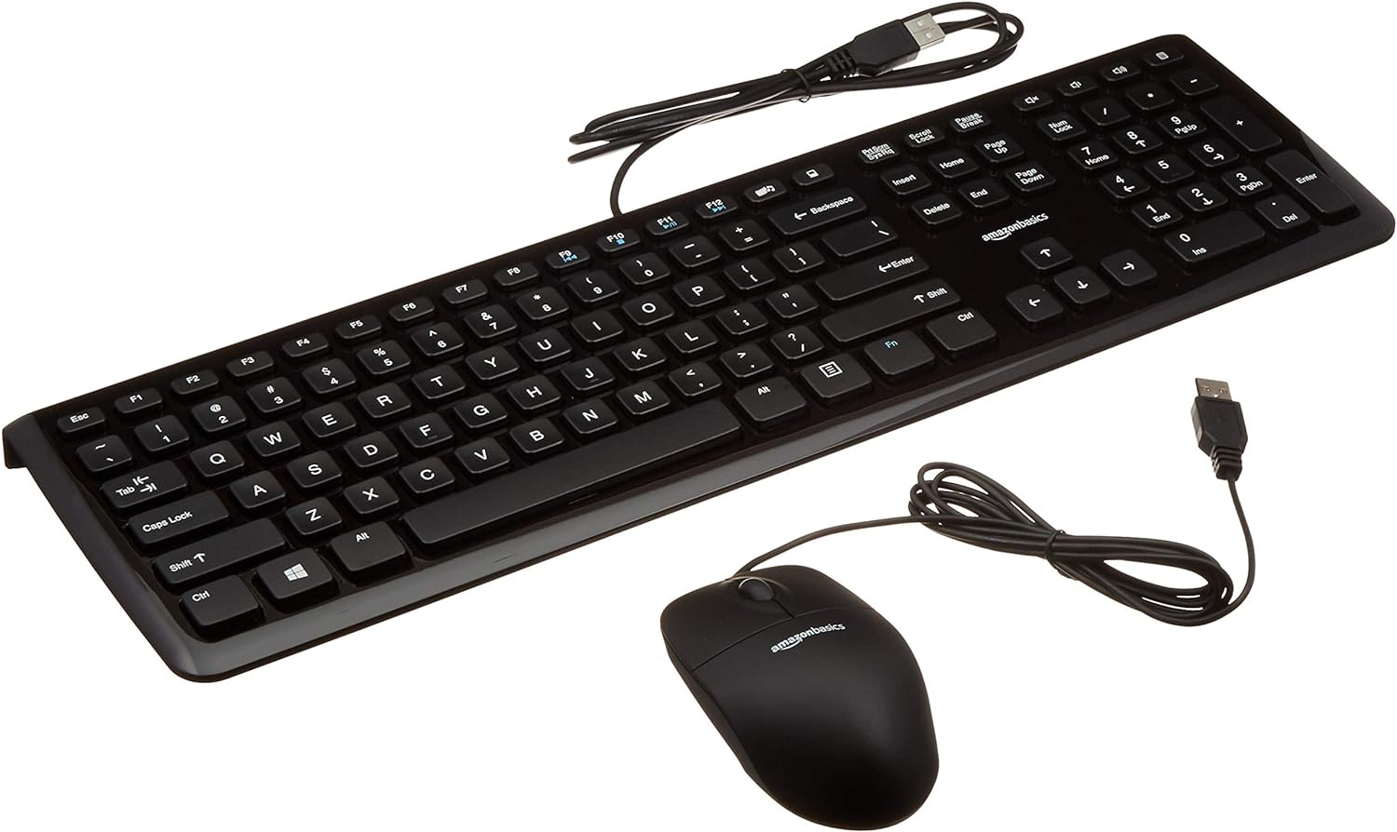
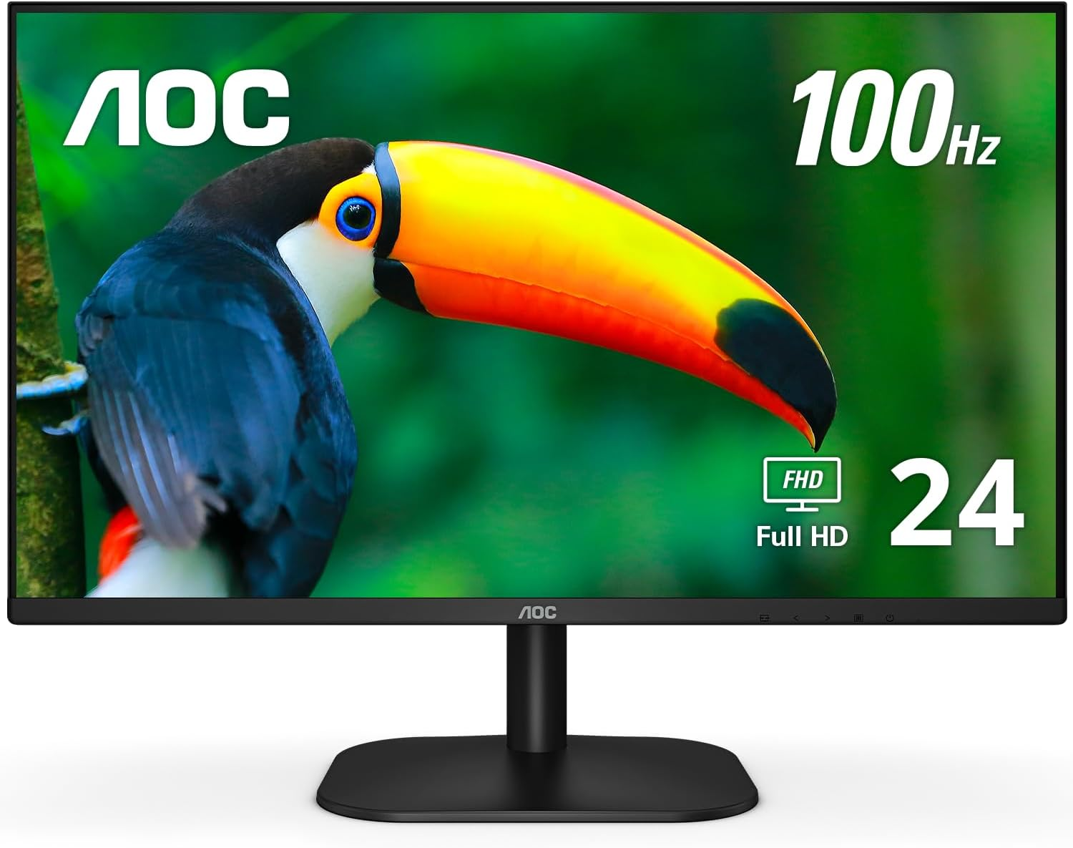
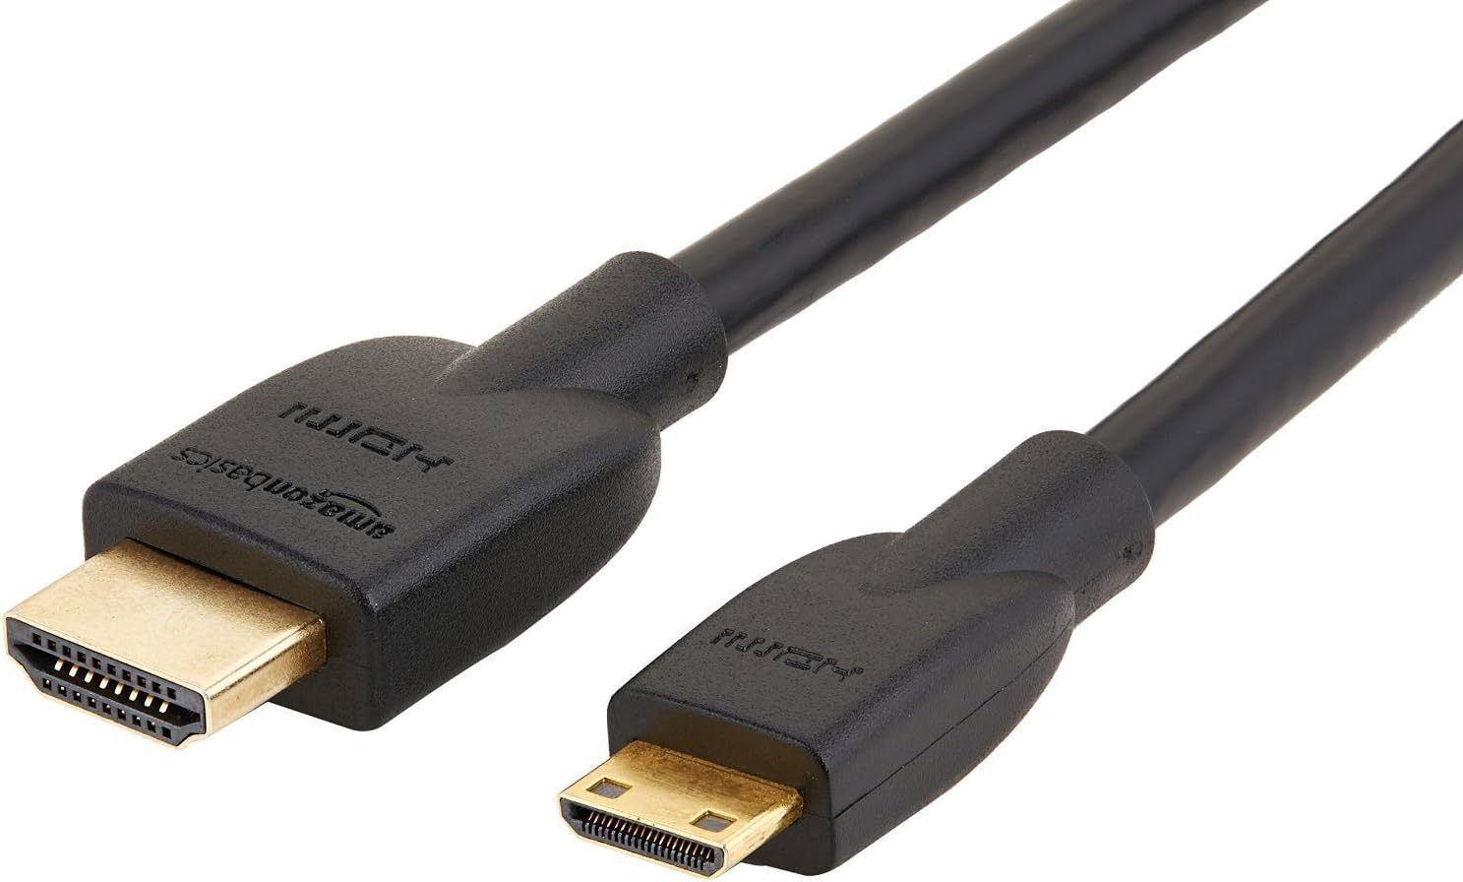
All Hardware Components
Micro SD Card
Male-Female Jumper Wires
RFID Card Tag
Key Fob Tag
Keyboard and mouse
Monitor
Mifare RC522
Module RFID Reader
Raspberry Pi 4 Model B
Breadboard
Mini HDMI to HDMI Adapter Cable

